Slide 1

Understanding ‘mtcars’ Data
Alberta “Albi” Kovatcheva

Slide 2

Background
The information in the ‘mtcars’ data set was extracted from the 1974 Motor Trend US magazine and comprises fuel consumption and 10 aspects of automobile design and performance for 32 automobiles (1973-74 models).

Slide 3
Cars Task
From the ‘mtcars’ data frame, create a boxplot of miles per gallon (the mpg variable) grouped by the number of cylinders in the engine (the cyl variable). Do these box plots make sense? Also, use the summarize() and group_by() functions to compute how many cars have four cylinders, how many have six, and how many have eight.
Prepare a report (using MS Power Point or similar) with all of these elements and any code used to arrive at the results.

Slide 4
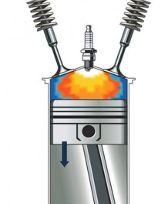
Cylinders
A cylinder is the chamber where the gasoline is burned and turned into power.
Most cars and SUV engines have 4, 6, or 8 cylinders.
Generally, an engine with more cylinders produces more power, while an engine with fewer cylinders gets better fuel economy.

Slide 5
View the ‘mtcars’ Data Frame
Code to view data:
library("dplyr")
View(mtcars)
head(mtcars)
 | mpg | cyl | disp | hp | drat | wt | qsec | vs | am | gear
Mazda RX4 | 21.0 | 6 | 160 | 110 | 3.90 | 2.620 | 16.46 | 0 | 1 | 4
Mazda RX4 Wag | 21.0 | 6 | 160 | 110 | 3.90 | 2.875 | 17.02 | 0 | 1 | 4
Datsun 710 | 22.8 | 4 | 108 | 93 | 3.85 | 2.320 | 18.61 | 1 | 1 | 4
Hornet 4 Drive | 21.4 | 6 | 258 | 110 | 3.08 | 3.215 | 19.44 | 1 | 0 | 3
Hornet Sportabout | 18.7 | 8 | 360 | 175 | 3.15 | 3.440 | 17.02 | 0 | 0 | 3
Valiant | 18.1 | 6 | 225 | 105 | 2.76 | 3.460 | 20.22 | 1 | 0 | 3

Slide 6
Cars Understanding the ‘mtcars’ Data Frame
Code to help understanding of data:
help(mtcars)
Format
A data frame with 32 observations on 11 (numeric) variables.
[, 1] mpg Miles/(US) gallon
[, 2] cyl Number of cylinders
[, 3] disp Displacement (cu.in.)
[, 4] hp Gross horsepower
[, 5] drat Rear axle ratio
[, 6] wt Weight (1000 lbs)
[, 7] qsec 1/4 mile time
[, 8] vs Engine (0 = V-shaped, 1 = straight)
[, 9] am Transmission (0 = automatic, 1 = manual)
[,10] gear Number of forward gears
[,11] carb Number of carburetors

Slide 7
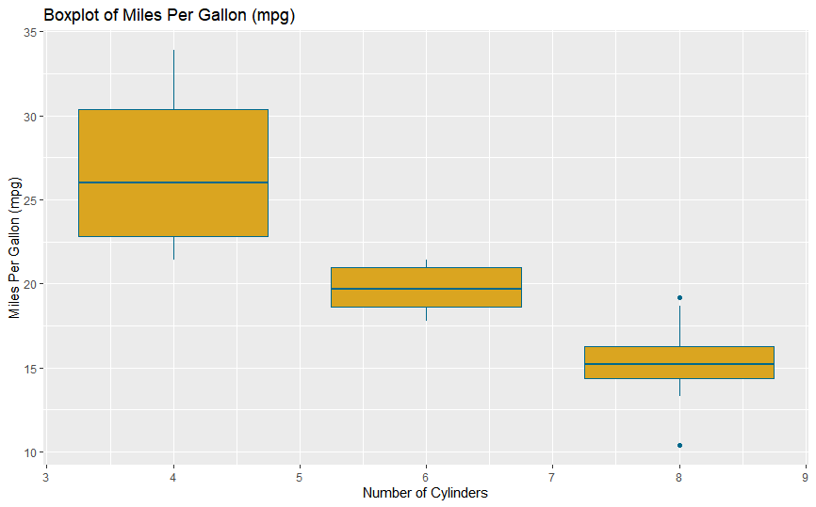
Boxplot: Number of Cylinders vs. Mileage
Code to create this boxplot:
# Boxplot
ggplot(mtcars, aes(x = cyl, y = mpg)) +
geom_boxplot(aes(group = cyl), fill = "goldenrod", color = "deepskyblue4") +
ggtitle("Boxplot of Miles Per Gallon (mpg)") +
xlab("Number of Cylinders") +
ylab("Miles Per Gallon (mpg)")

Slide 8
Analysis
The boxplot shows that the cars with fewer cylinders have a better fuel economy than the cars with more cylinders.
In other words, the boxplot shows a negative correlation between the number of cylinders and the cars’ fuel economy (miles per gallon).

Slide 9
Cars Count of Cars by Number of Cylinders
Code to count cars by their number of cylinders:
mtcars %>% group_by(cyl) %>% summarize(Count = n())
# A tibble: 3 x 2
cyl Count
<dbl> <int>
1 4 11
2 6 7
3 8 14

Slide 10
Cars Analysis
There are 32 cars in the ‘mt cars data set’.
Of these 32 cars, 11 of them have 4 cylinders, 7 of them have 6 cylinders, and 14 of them have 8 cylinders.
8-cylinder cars have the highest count.
However, the cost of the cars in the data frame have less than 8 cylinders.
# A tibble: 3 x 2
cyl Count
<dbl> <int>
1 4 11
2 6 7
3 8 14

Slide 11
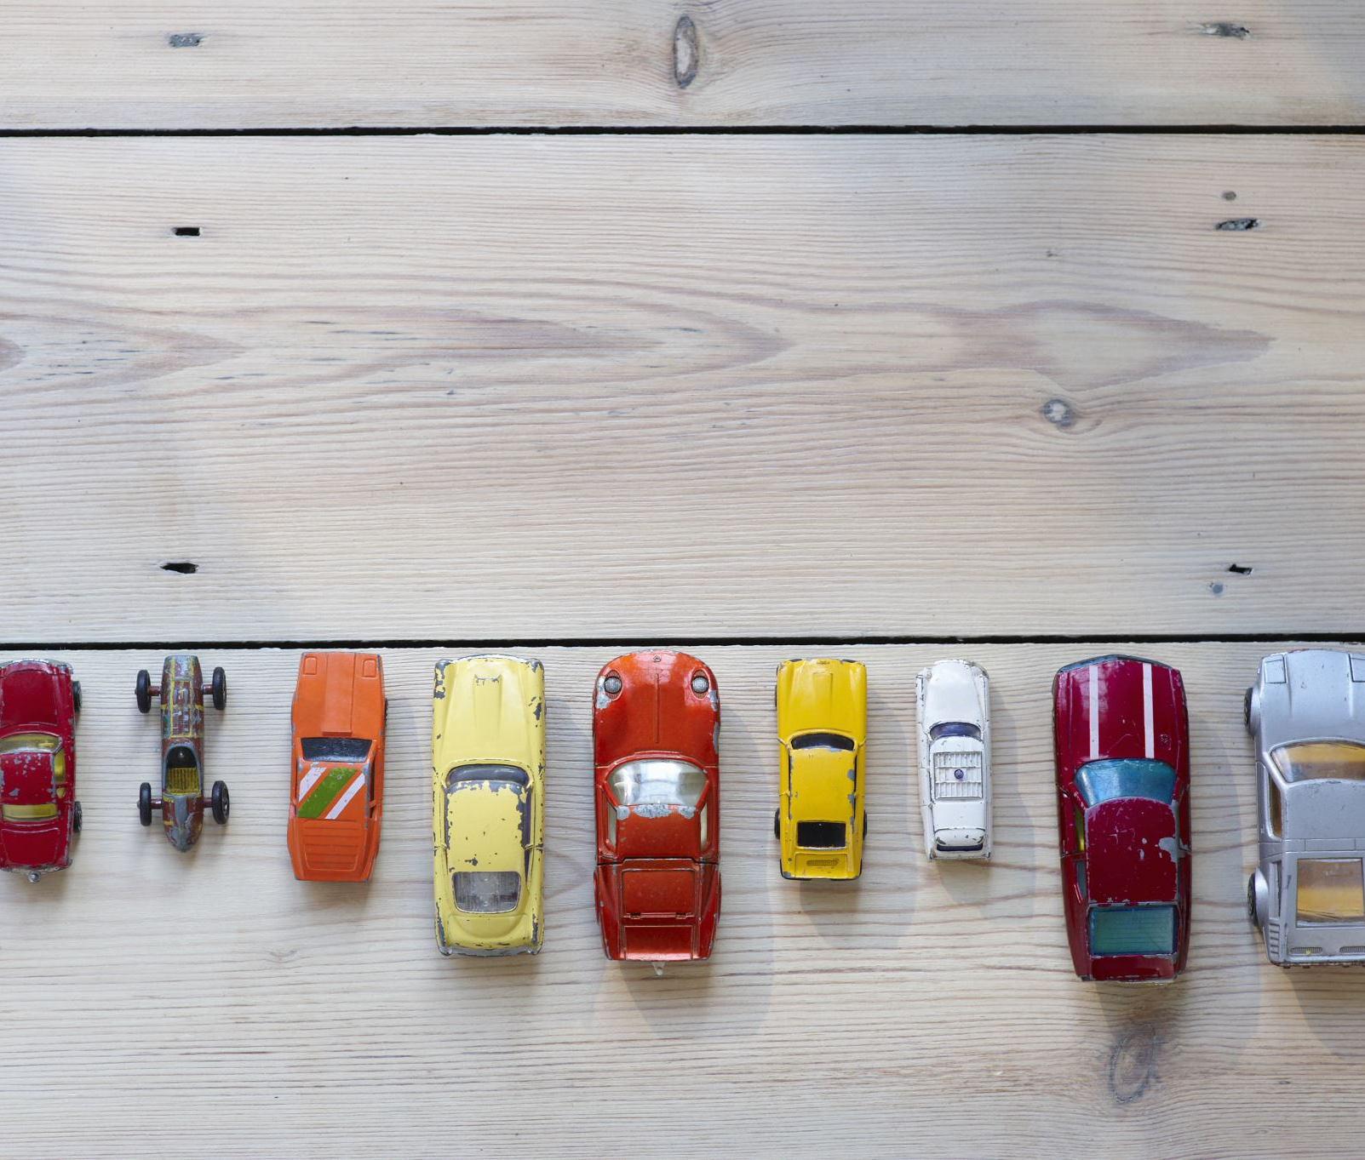
Conclusion
Due to their fuel economy, most drivers might prefer 4-cylinder cars to 6- and 8- cylinder cars.
However, 8-cylinder cars are useful for high-power applications such as racing.

